Slide 1
Sentimental Analysis
CAPSTONE PROJECT
Presented By:
- Thota Sravya Vardhani
- Vignan Nirula Institue Of Technology and Science for Women
- Information Technology - IT

Slide 2
OUTLINE
Problem Statement (Should not include solution)
Proposed System/Solution
System Development Approach (Technology Used)
Algorithm & Deployment
Result
Conclusion
Future Scope
References

Slide 3
Problem Statement
Example:
Develop a Sentimental Analysis Model to classify Restaurant Reviews as positve or negative .
This model will provide businesses with vauable insights into customer satisfaction and helpthem make data - driven decisions to improve their services.

Slide 4
Proposed Solution
The proposed system aims to classify restaurant reviews as positve or negative and also addresses the analysis of customer reviews,with the rapid growth of online platforms for sharing opinions and reviews,restaurents often rely on the customer feedback to imporve their services and attract a new customers.
Data Collection:
Gathers all the REVIEWS and LIKES given to that review in Social media for that restaurant
Utilized these reviews can be taken from social media platforms like Google, Zomato, Swiggy.... and they are collectively gathered into a .CSV file named as ‘Reviews.csv’.
Data Preprocessing:
Clean and preprocess the collected data to handle missing values, outliers, and inconsistencies.
Machine Learning Algorithm:
Implemented a machine learning algorithm - Naive Bayes Algorithm to analyse restaurant reviews.
Deployment:
Develop a user-friendly Machine Learning training model, that provides real-time predictions for any kind of restaurant reviews.
Deploy the solution, by the accuracy score and classification report .
Evaluation:
Assess the model's performance using appropriate metrics such as Accuracy Score, Classification report, or other relative plots representations like Bargraph....
Fine-tune the model based on feedback and continuous monitoring of prediction accuracy.
Result: Analyzed reviews either positive or Negative .

Slide 5
System Approach
The "System Approach" section outlines the overall strategy and methodology for developing and implementing the Restaurant Reviews Sentimental Analysis prediction system. Here's a suggested structure for this section:
System requirements :
Windows OS or IOS - PC(Personal Computer) ,
Anaconda - Jupyter or Google Colab with all below libraries or pip install them.
Data set of Restaurant Reviews - in .csv format (columns : Reviews and Likes) .
Library required to build the model:
pandas
matplotlib
sklearn(Scikit Learn)(feature_extraction,model_selection,naive_buyes,metrics)
seaborn
WordCloud
collections
nltk (stem,corpus,tokenize)
contractions
beautifulsoup4 (bs4)

Slide 6
Algorithm & Deployment
In the Algorithm section, describe the machine learning algorithm chosen for Analysing Restaurant Reviews. Here's an example structure for this section:
Algorithm Selection :
Naive bayes(MultinomialNB) :
This algorithm chosen due to its simplicity, efficiency, and strong performance with text data.
Here the Text data is seperated into a Matrix - Scenario of Naive Bayes excels
Data Input :
This Algorithm took TF-IDF vectorized (Term Frequency-Inverse Document Frequency : can be used to give more weight to important words and less to common words), Emojis Removed, lemmatized,Stemmed(Original form of word), Special Characters(@,!...) removed, Numbers (1,2,3,0,....) removed Restaurant Reviews column from data set .
Training Process:
Historical Data: The dataset of text reviews and their sentiment labels is cleaned and prepared.
Feature Extraction: Text data is converted into numerical features using vectorizers.
Train-Test Split: The data is split into training and testing sets.
Model Training: The Naive Bayes model is trained on the training set.
Model Evaluation: The model is evaluated using various metrics -accuracy score ..........
Prediction Process:
In this the moodel will do prediction process, by using test (x_test & y_test) data by .predict(x_list) . if the o/p of this matched with the y_train data the data accuracy is tested and predicted .

Slide 7
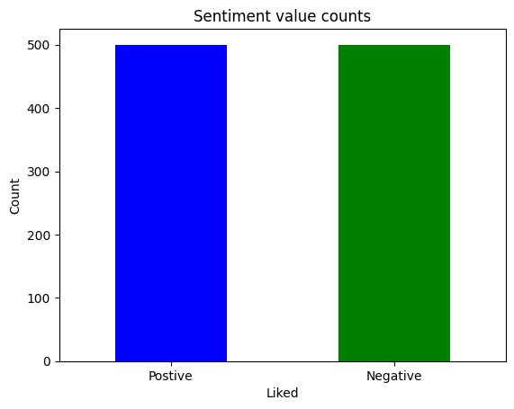
Result
Bargraph for ‘ Liked ‘ Value Counts:
In this barplot we identify two X- plots they are Positive and Negative :
In the Data set, if ‘Liked’ - 0 - Negative
1 - Positive
checking the value counts of ‘Liked’.
For our data set that we had given the result is
Liked
1 500
0 500
So the plotting shows equal for both positive and negative.
Library : matplotlib.pyplot

Slide 8
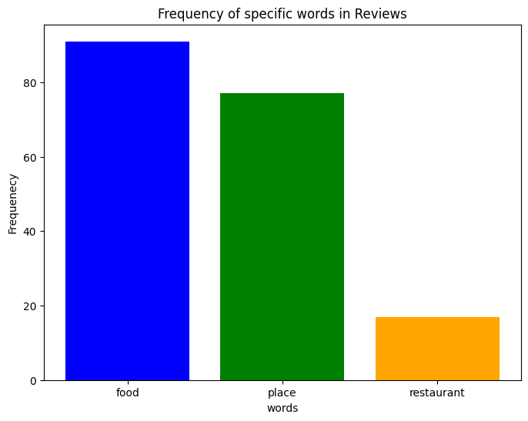
Result
Frequency of specific words :
Library - matplotlib.pyplot(To plot)
By dictionary usage with keys: word
values: word count
{food: 90, place: 75 ,restaurant: 10}
By giving the dictionary ‘ keys to x - axis ‘ and ‘values to y-axis’ of plot() -The graph will be plotted.
OUTPUT : Bar plot with - food: 90(Blue), place: 75(green) ,restaurant: 10(yellow)

Slide 9
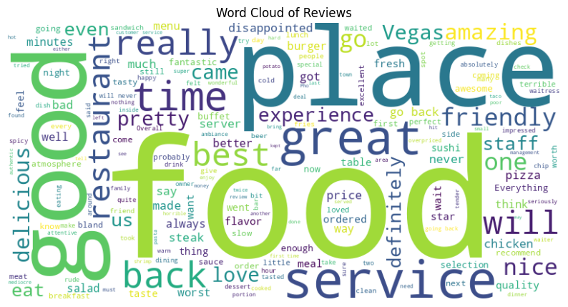
ReSult
Word Cloud
Library - wordcloud
This gives us the CLOUD that contains the words that are mentioned in Dataset .
The size of the word in cloud will be based on how many times it is spelled or used in dataset
In our data set - Reviews , The majority spelled or used word is ‘food’ and next ‘place’ , ‘good’ based on no of times the word mentioned in the reviews the size is defined in the word cloud

Slide 10
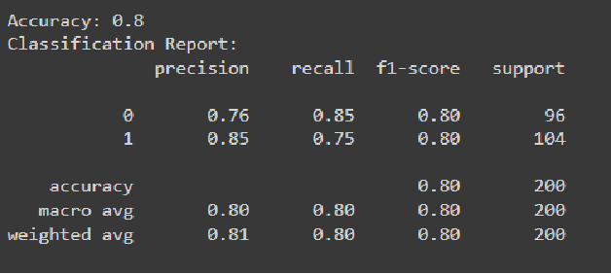
FINAL Result
Naive Bayes ML model OUTPUT:
Library - sklearn.model_selection, metrics, naive_bayes
After Performing : some data processing like Lemmatization, removing symbols, numbers, stopwords, stemming, emojis, links and TF- IDF Vectorization
That Processed data is given to Naive Bayes ML model that by taking Splitting,Analysing, Predict(Testing) and give final Accuracy score including Reviews and Liked data.
0.8 - 80 % Accuracy and the clasification report as side given

Slide 11
Conclusion
This suggests that the Restaurant reviews are generally positive
The model achieved an accuracy of 80%, indicating it is fairly reliable in classifying reviews as positive or negative. The precision, recall, and f1-scores for both classes (positive and negative reviews) are also quite balanced,
With f1-scores of 0.80 for both classes. This suggests that the restaurant reviews are generally positive, given that the model performs well in identifying positive reviews (class 1) with a precision of 0.85 and recall of 0.75.
Challenges Encountered
Data Quality: The dataset might have had duplicated reviews, numeric , symbolised which could affect the training process.
Feature Extraction: Converting textual data to numerical format while retaining semantic meaning is challenging. TF-IDF worked here (but some times not be).
Potential Improvements
Data Preprocessing: Implement more sophisticated text preprocessing techniques, such as stemming, lemmatization, and handling negations.
Using TF-IDF vectorizer, Naive Bayes model.

Slide 12
Future scope
By incorporating additional data sources, optimizing algorithms, and expanding the system to multiple regions, the sentiment analysis for restaurant reviews can be significantly enhanced.
Integrating emerging technologies such as edge computing and advanced machine learning techniques will further improve the system's accuracy, scalability, and real-time processing capabilities.
This comprehensive approach will provide restaurant owners with deeper insights into customer sentiment, enabling them to make data-driven decisions to improve their services and customer satisfaction..

Slide 13
References
Dataset link : https://www.kaggle.com/datasets/vigneshwarsofficial/reviews
https://scikit-learn.org/stable/ - Scikit Learn / SKlearn Library (Naive_Bayes ML model)
https://matplotlib.org/ - Matplotlib
https://pandas.pydata.org/ -Pandas
https://pypi.org/project/beautifulsoup4/ - beautifulSoup4 -bs4

Slide 14
THANK YOU

